Slide 1
BVs AFFECTIONS

Slide 2
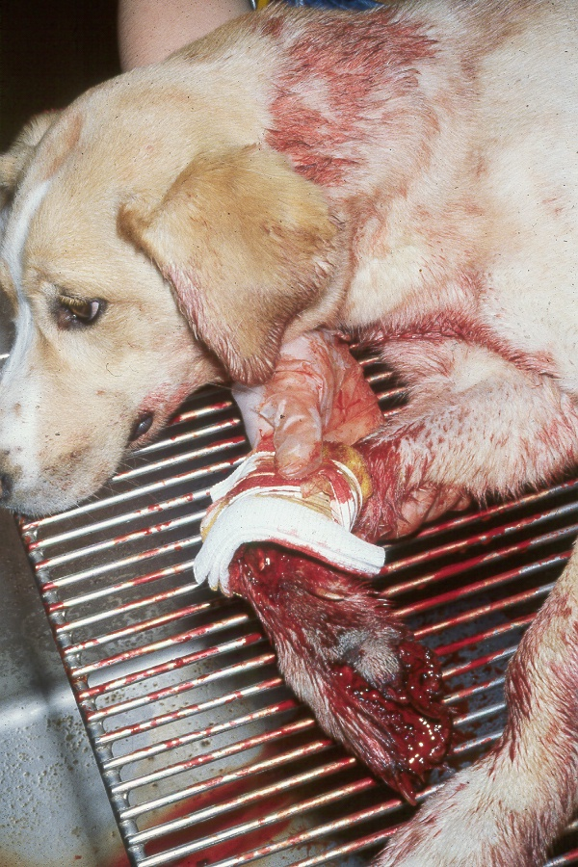
I-AFFECTIONS OF ARTERIES
1-Wounds
A-Contusions
B-Open Wounds
Characteristics
1-Jets
2-Bright red
3-Arrested by pressing cardiac side

Slide 3
Treatment
1-General treatment of the associating wound by suturing
2-Control of infection and stimulation of healing
3-Control of hemorrhage

Slide 4
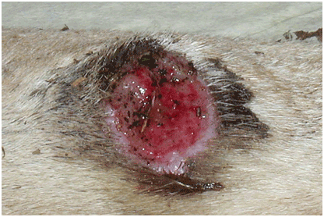
2-Ulceration of Artery
Treatment
1-Treatment of the associating cause
2-Control of hemorrhage

Slide 5
3-Rupture of Artery
Superficial
Internal
Treatment
superficial ruptures treated as hematoma, while internal ruptures are usually out of treatment

Slide 6
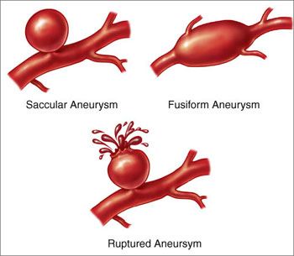
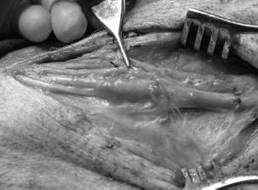
4-Aneurysm
Treatment
Ligation of the artery and extirpation

